Slide 1

Delivering Finance Training That Sticks –
Principles of Training Transfer Effectiveness
WEDNESDAY FEBRUARY 19, 2025

Slide 2


Slide 3

Introductions –
Let us get to know ourselves

Slide 4

FACILITATOR’S
PROFILE
CEO, M.Bryan Consulting Limited
About Me:
Ex-Banker
CEO
Mother of Five Children
IFC Global Master Trainer
Nigeria’s First Certified Transfer Designer
Transfer Enabler for Africa – Institute for Transfer Effectiveness
Resource Person Lagos Business School
Certified Transformational Coach
Certified Team and Group Coach
Certified Kirkpatrick Professional
Teacher/Trainer – 26 years (Formal and Informal)
Soon to be Certified:
1. Accelerated Learning by Tom Meier
2. High Performance Learning Journeys Certification by Promote – Prof. Robert Brinkerhoff
Sandra Ihenacho aka The Oracle
A Training Transfer Effectiveness Advocate

Slide 5

HOUSE KEEPING

Slide 6



Who is in the room?
Go to slido.com and use the code 2568443 to join in.

Slide 7

SESSION OBJECTIVES
By the end of this webinar, you should be able to:
Define the principle of Training Transfer Effectiveness and its application in finance training.
Identify barriers to training transfer specific to finance-related topics and outline strategies to overcome them.
Apply the 12 Transfer Levers to create training programs that ensure real-world application.
Plan your next line of action after this webinar what you will either Stop doing, Start doing, or Continue to do.

Slide 8

SESSION ROADMAP
Polls
Q&A
Case Study
Interactions
Your next line of Action

Slide 9


The What Factor!
What do you hope to learn from today’s webinar?

Slide 10

Training Scrap
Do you know that 85% of finance training content is forgotten within 30 days?
How do we change this?

Slide 11
THE TRAINING TRANSFER EFFECTIVENESS
JOURNEY
THE JOURNEY BEGINS HERE AND NOW.
Pre–Training
During Training
Post–Training

Slide 12
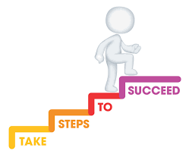
What you will learn in today’s
Webinar
The principle of Training Transfer Effectiveness and its application in finance training.
Identify barriers to training transfer specific to finance-related topics.
Outline strategies to overcome them.
Apply the 12 Transfer Levers to create training programs that ensure real-world application.

Slide 13
What exactly is Training Transfer Effectiveness?
Training Effectiveness
Training Transfer
Training Transfer Effectiveness

Slide 14
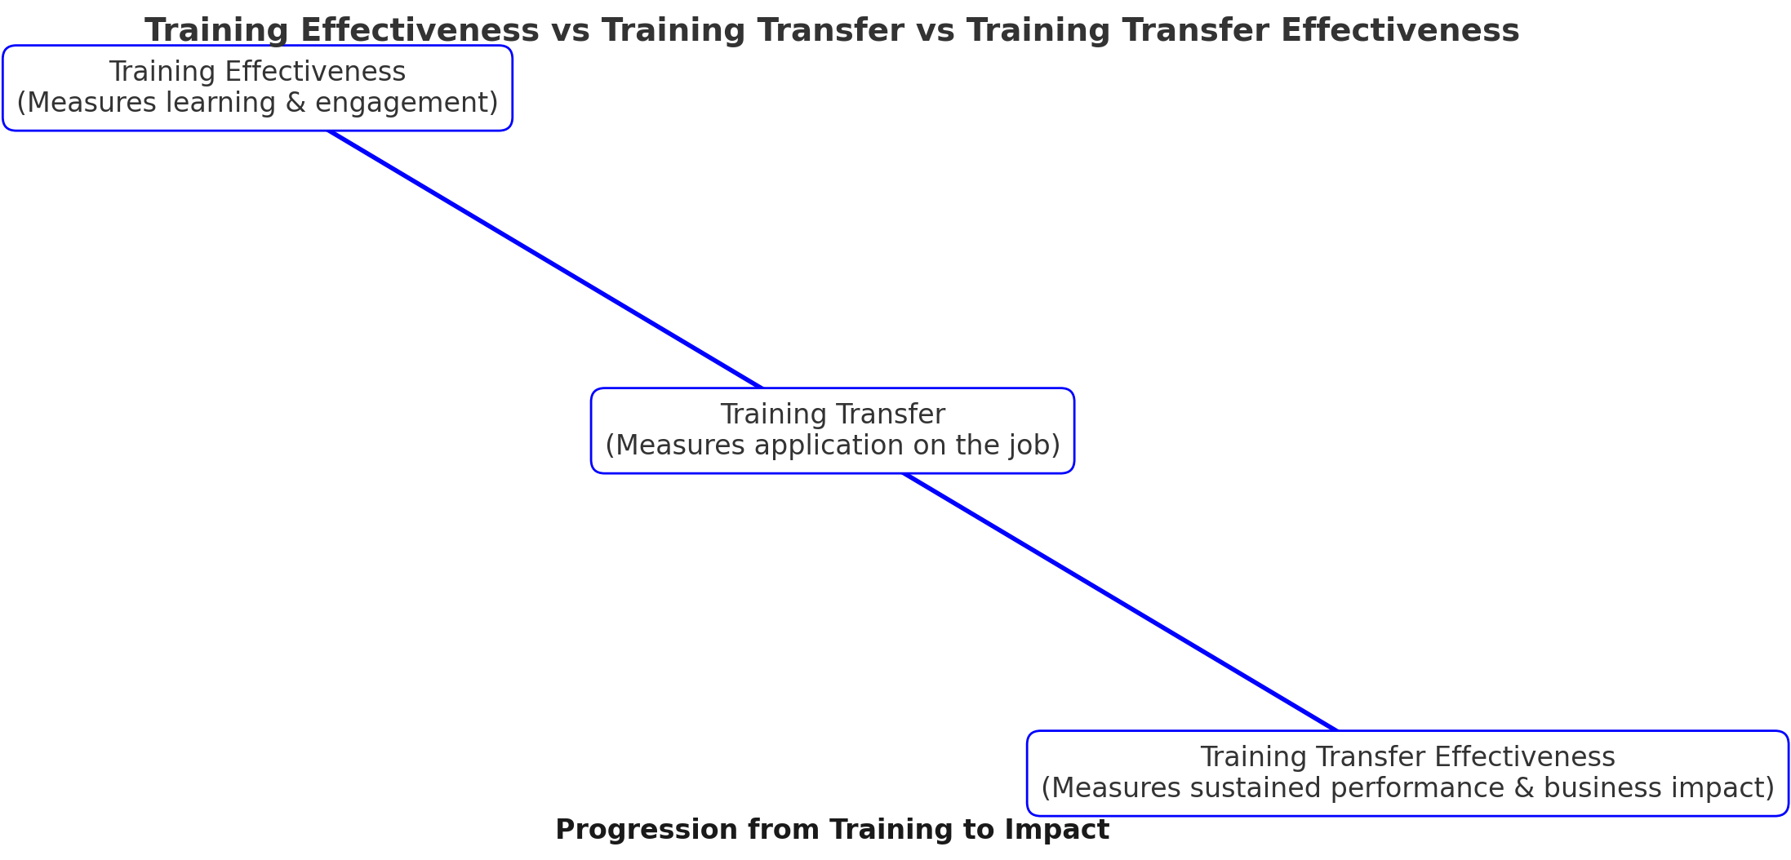
From Training To Impact

Slide 15

Case Study – Ukuaji Capital
When Training is a Ritual, not a Business Strategy.
Required:
What went wrong/right in the training selection process, and how did it contribute to the financial loss?
Why did the training work for Rebecca and Daniel but not for Mr. Francis?
What role did post-training support (or lack of it) play in the outcome?
What would you recommend ensuring future training success at Ukuaji Capital?

Slide 16
Why doES finance training fail?
Go to slido.com and use the code 2568443 to join in.

Slide 17

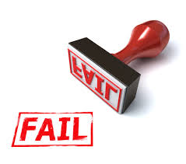
Why does Finance Training fail?
Money Drain
Pre-Training Failures (Before Training Begins)
Non-Alignment with Business Goals.
Poor Training Selection Process.
During-Training Failures
Training Content is Not Job-Relevant.
Lack of Engagement and Active Practice.
Post-Training Failures (After Training Ends)
No Opportunities for Application.
No Manager or Organizational Support.

Slide 18
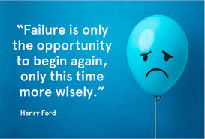
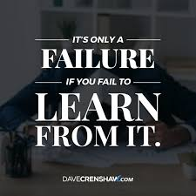
Finance training fails when:
It isn’t aligned with business goals.
The wrong people are trained.
Content is not practical or engaging.
Employees don’t get to apply their learning.
There is no organizational reinforcement.
Fixing This:
Organizations must prioritize business-aligned training, engage learners through active practice, and ensure post-training accountability.

Slide 19
The 12 Levers of Transfer Effectiveness
Trainees, Training Design, and Organization
Levers for Trainees:
1. Transfer Motivation
2. Self-Efficacy
3. Transfer Volition
Levers for Training Design:
4. Clarity of Expectations
5. Content Relevance
6. Active Practice
7. Transfer Planning
Training Design
Organization
Trainees

Slide 20
The 12 Levers of Transfer Effectiveness
Training Design
Organization
Trainees
Levers for the Organization:
8. Opportunities for Application
9. Personal Transfer Capacity
10. Support from Supervisors
11. Support from Peers
12. Transfer Expectations in the Organization
Since we don’t have time to go deep into all 12, we will focus on the key levers that directly impacted Ukuaji Capital."

Slide 21

Putting the dots together
Training Alone is Not Enough—Sustaining Application is Key
Training Effectiveness = Learning happens.
Training Transfer = Learning is applied.
Training Transfer Effectiveness = Learning is sustained for long-term impact.
👉 Without reinforcement, training remains an event, not a transformation.
The Ukuaji Capital Case Study: The Cost of Training Without Strategy
Right training, wrong participant = no impact.
Training works when it is relevant, engaging, and reinforced.
Without post-training support, employees revert to old habits.
👉 Training must be a strategic investment, not a routine exercise.

Slide 22


Putting the dots together
Key Barriers & Solutions
Before Training: Misalignment, poor selection, no skills assessment.
During Training: Theory-heavy, passive learning, outdated content.
After Training: No follow-up, lack of application, no accountability.
👉 Fix this with clear alignment, engaging methods, and structured post-training support.

Slide 23
“Training is not the solution until the problem is understood.
Needs Validation ensures that every intervention is intentional, impactful, and aligned with business success.” — Sandra The Oracle
The Training Transfer Effectiveness Advocate
Notes:
Finally.

Slide 24

A Call to Action
MY NEXT LINE OF ACTION

Slide 25

QUESTIONS

Slide 26


📢 Next Steps
✅ Apply these principles in all your finance training.
✅ Join ITTEC 2025 for deeper insights – https://www.itteconference.com/
✅ Connect with Sandra The Training Transfer Effectiveness Advocate to continue the conversation!

Slide 27
A Call to Action
MY NEXT LINE OF ACTION

Slide 28
“Training is not an event; it is a journey.
True effectiveness comes from a structured Pre, During, and Post Training approach—without it, training is just an activity, not transformation.”—
Sandra The Oracle
The Training Transfer Effectiveness Advocate

Slide 29

CONCLUSION

Slide 30


Success doesn’t come cheap; it comes with hard work.
Are you willing to pay the price for success?
The choice is yours now.
What will it be?

Slide 31


FINALLY
AND FEEL GOOD ABOUT
YOURSELF ALWAYS

Slide 32

Coach Sandra Ihenacho
aka The Oracle
The Training Transfer Effectiveness Advocate
+234 8096691953
LinkedIn: Sandra Ihenacho
Instagram: @sandra4_oracle
X: @oraclesandra
sandra@mbryanconsultinggroup.com

