Slide 1

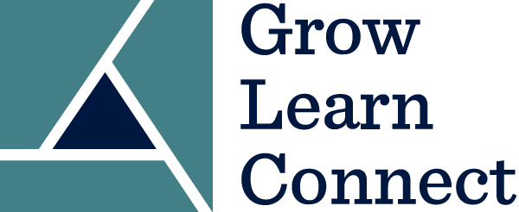
Taking Grow Learn Connect Courses
on the WBG Edcast Platform
Registration and Login Instructions
New User
Sign-up & login
Existing user
Login

Slide 2
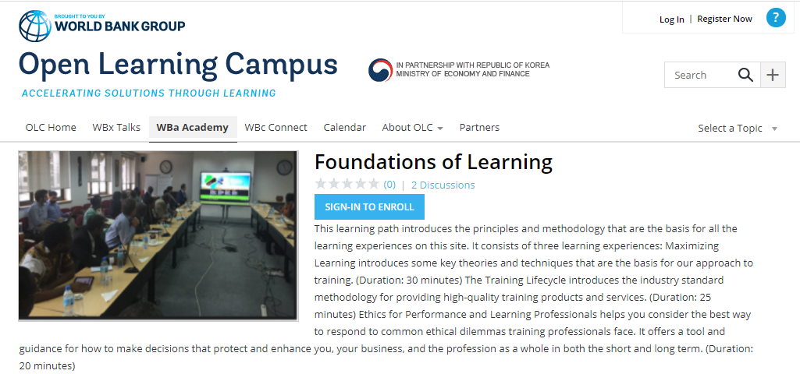
Once you click on the course link on the GLC website, you will be taken to the hosting platform – WBG Edcast

Slide 3
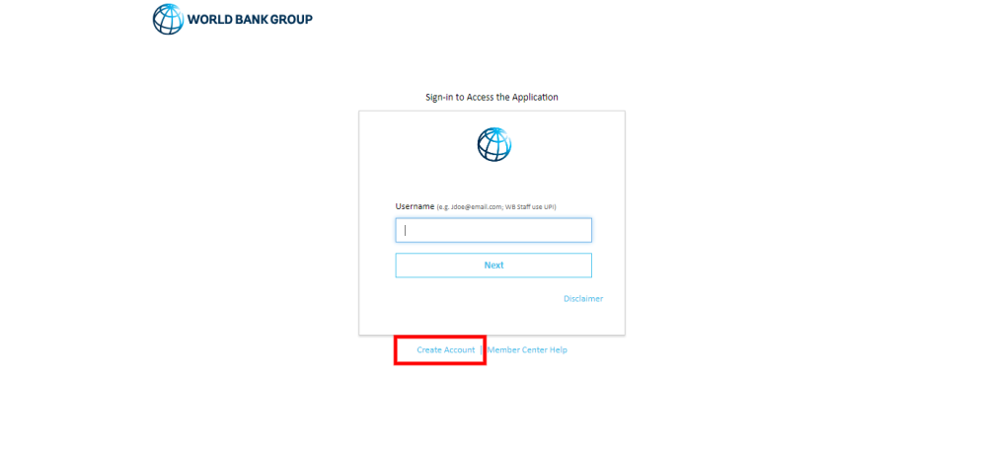
2. You will be redirected to the screen below with the option to log in and also to Create Account. If you already have an Edcast or GLC account, you can directly sign in. To create an account, click on “Create Account”.

Slide 4
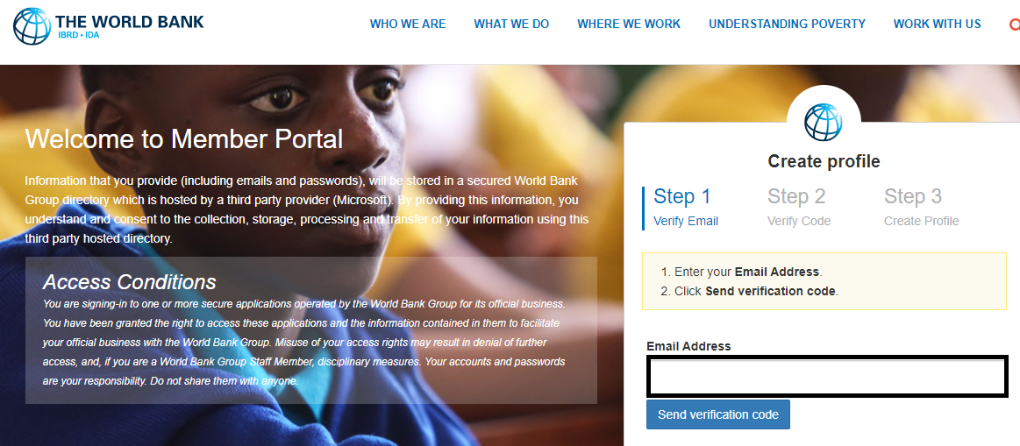
3. In the sign-in form, provide an email and click on the button “Send Verification Code”. Then access your personal email account, where you should have received an email with a code. The email would be from Microsoft on behalf of The World Bank Group.

Slide 5
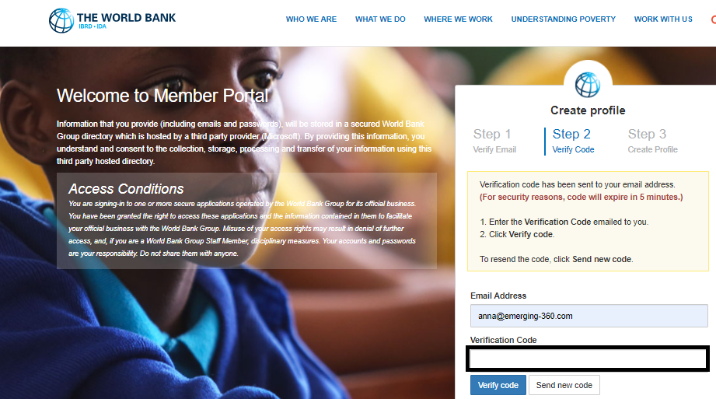
4. Enter the verification code and click on “Verify Code”.

Slide 6
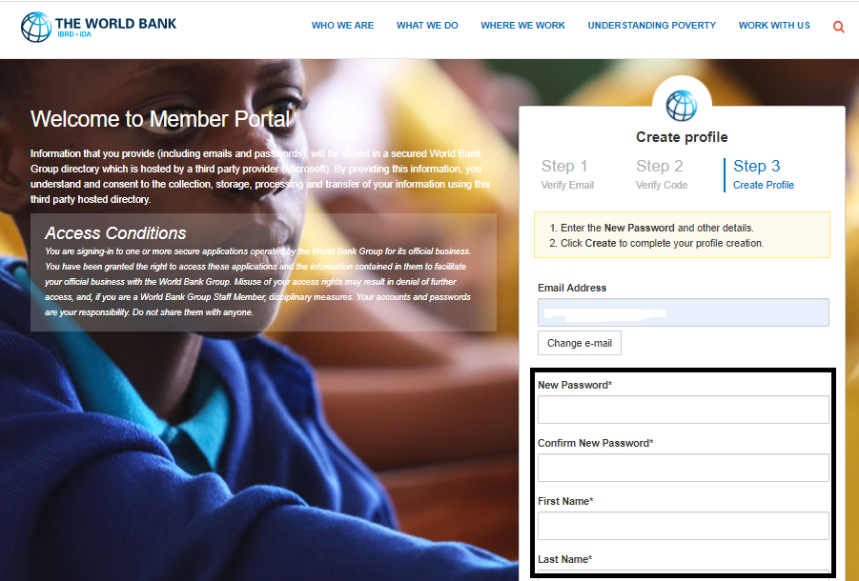
5. Once the code is validated, fill in the remaining fields, such as password, first name, last name, etc., and click on the Create button. Your password must have at least 3 of the following: a lowercase letter, an uppercase letter, a number, and a symbol.

Slide 7
6. If you’re not immediately taken back to the GLC courses on Edcast, you can search for them by course names or you can enter the following urls into the address line:
Foundations of Learning (English): https://wbg.edcast.com/insights/foundations-of-learning
Foundations of Learning (French): https://olc.worldbank.org/content/les-fondements-de-lapprentissage
Finding your Path for Facilitation (English): https://wbg.edcast.com/insights/ECL-1bef9cb2-7e4b-4a1a-bcc6-992994d2a772
Finding your Path for Facilitation (French): https://wbg.edcast.com/insights/ECL-25ff0595-8cc2-401a-b937-72607ff0732a
More courses will be added soon. Stay tuned.
HAPPY LEARNING WITH GROW LEARN CONNECT

