Slide 1
KNOWLEDGE MANAGEMENT
Becoming more competitive and high-performing through effective knowledge management practices
Christian Elongué
Managing Director of Christian Elongue Consulting (CEC)
hello@christianelongue.com

Slide 3
Explain the importance of lifelong learning for individual and corporate growth
Demonstrate the added value of a KM strategy for an individual and organization's performance.
Master how to use KM tools to enhance productivity and increase influence.

Slide 4
Poll 1: Why are you attending this GLC Webinar on KM?
The topic looks interesting and I’m curious to know more.
It could contribute to my career or professional growth
It could contribute to my company’s growth
A colleague/friend suggested it to me
I came because I know the facilitator
My boss asked me to attend
I don’t know

Slide 5
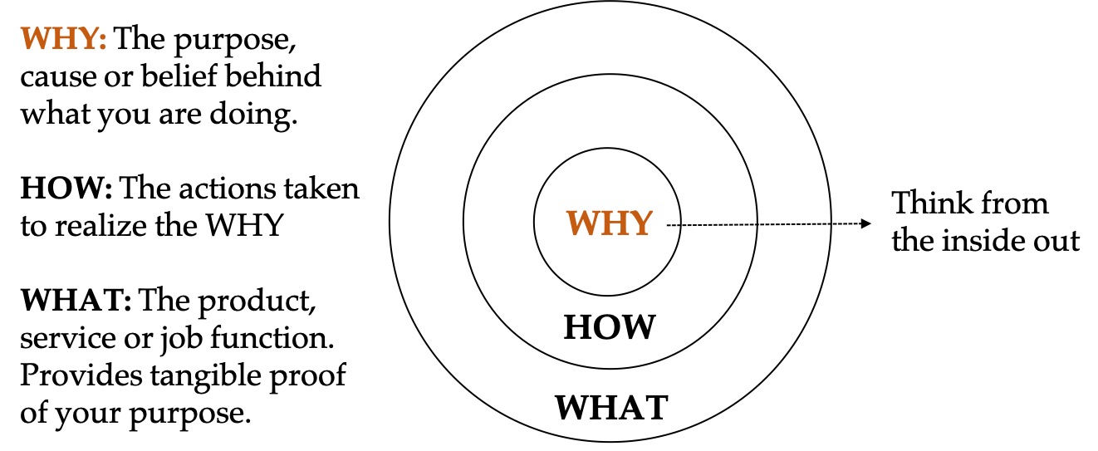

Always Start with the Why ?

Slide 6
ROADMAP

Slide 7

WHAT IS KNOWLEDGE?

Slide 8
HOW DO YOU DIFFERENTIATE KNOWLEDGE FROM WISDOM AND INTELLIGENCE?
“Knowledge is telling the past. Wisdom is predicting the future.” Timothy Garvey
“Knowledge comes from learning. Wisdom comes from living.” Anthony Williams
“Knowledge is having the right answer. Intelligence is asking the right question”
”For the Lord gives wisdom; from his mouth comes wisdom and understanding” Proverbs 2:6
“Knowledge is NOT power. Knowledge is only POTENTIAL power. Actions is power” Tony Robbins
“Only applied knowledge is power. Power produces knowledge” – Christian Elongué

Slide 9
WHY IS KNOWLEDGE IMPORTANT?

Slide 10
Activity 1
What are some of the problems you encounter in managing:
  Personal knowledge?
  Organisational Knowledge?
How many of you have suffered from this problem? Share examples of practical situations.
Do you have a personal/organisational learning plan/strategy?
Why do you think having a km strategy will be useful?

Slide 11
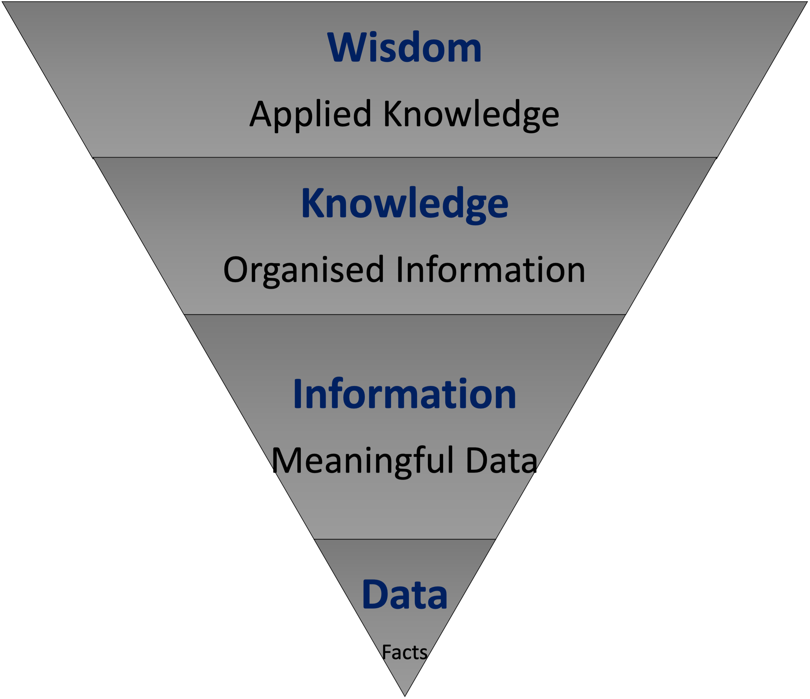
THE “DIKW” PYRAMID
The more we enrich our data with meaningful information, the more knowledge and insights we get and the more informed and data-based our decisions become

Slide 12
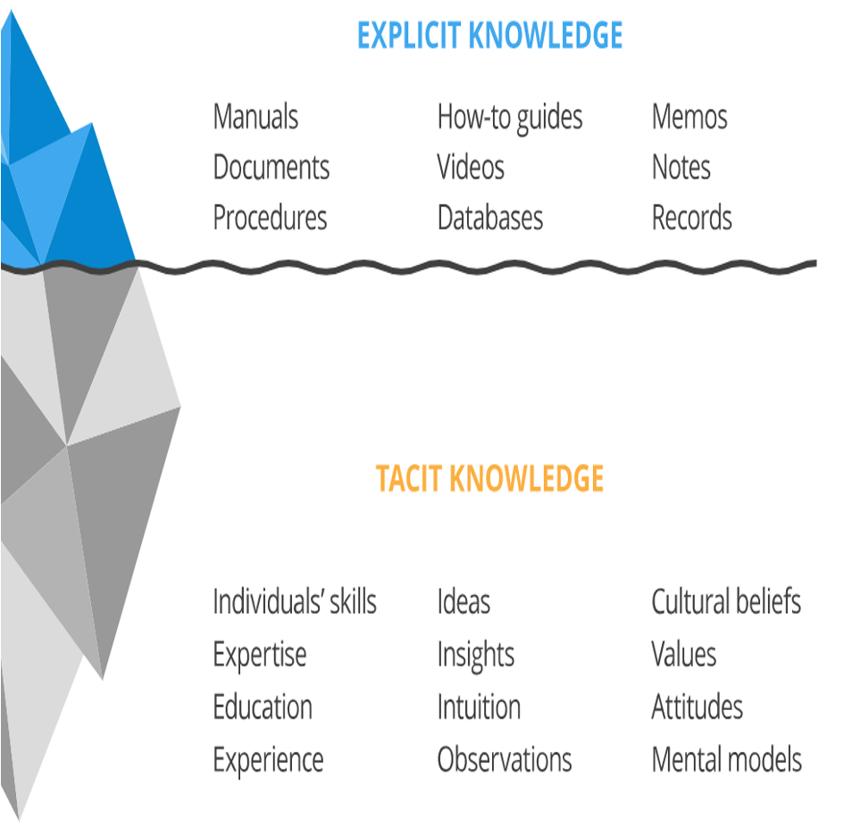
TYPES OF KNOWLEDGE

Slide 13

WHAT IS KNOWLEDGE MANAGEMENT?

Slide 14
WHAT ARE THE COMPONENT OF KM?
People
Strategy
Content
Process

Slide 15
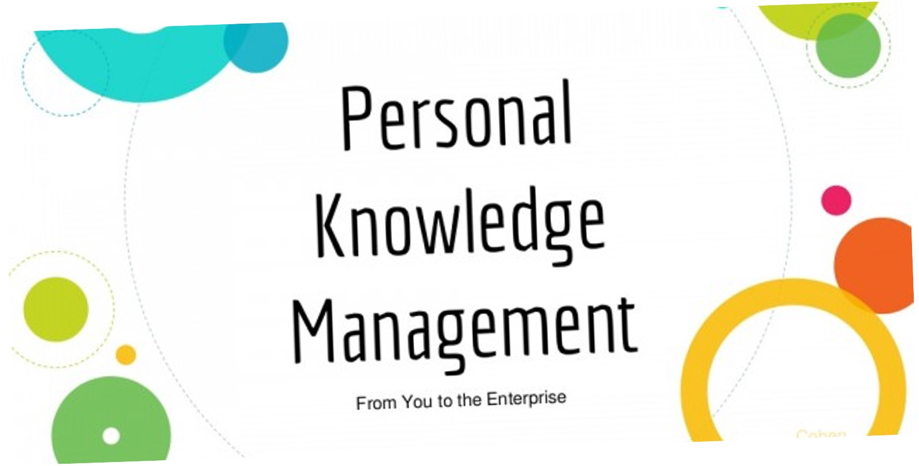
PERSONAL KNOWLEDGE MANAGEMENT

Slide 16
ACTIVITY 3
What are the obstacles/challenges you have in learning?
What are your personal knowledge management habits and tools ?
Do you think they are effective?
If yes/no, kindly explain and indicate how you could improve.
What would you do differently if you knew yourself better?

Slide 17
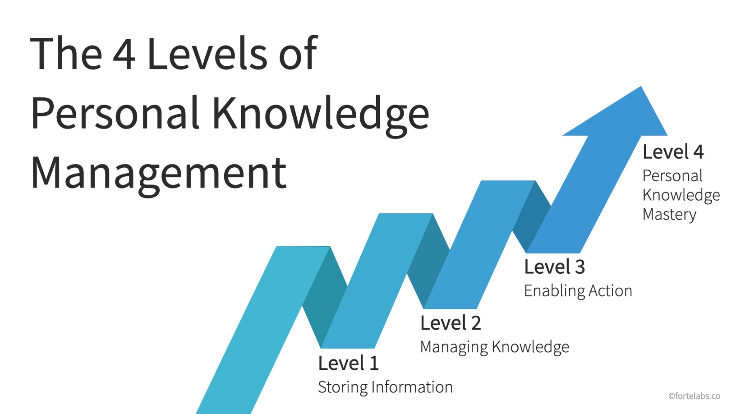
LEVELS OF PERSONAL KNOWLEDGE MANAGEMENT

Slide 18
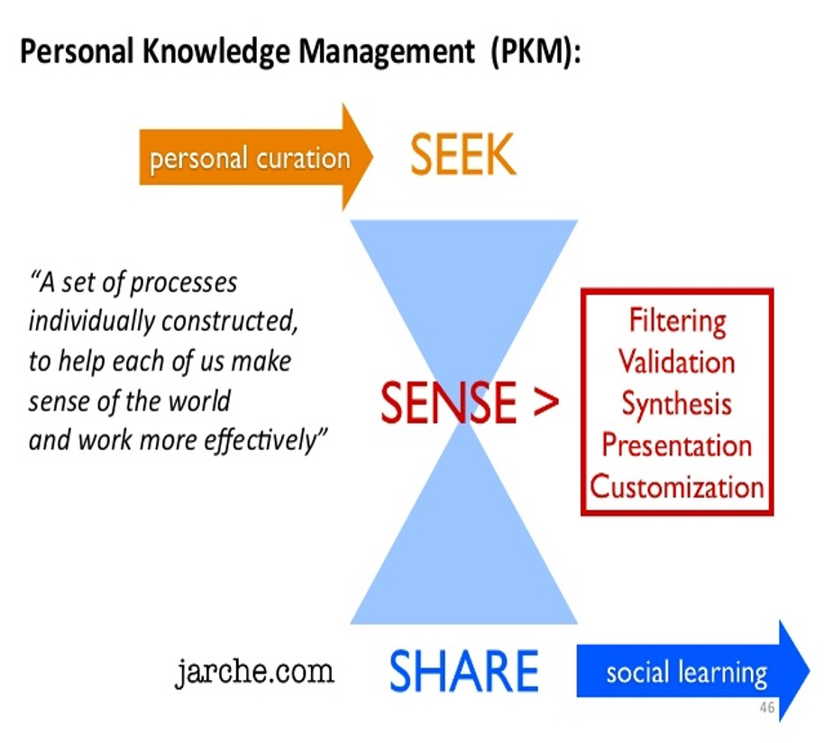

ZENITH OF PKM: Lifelong Learning

Slide 19
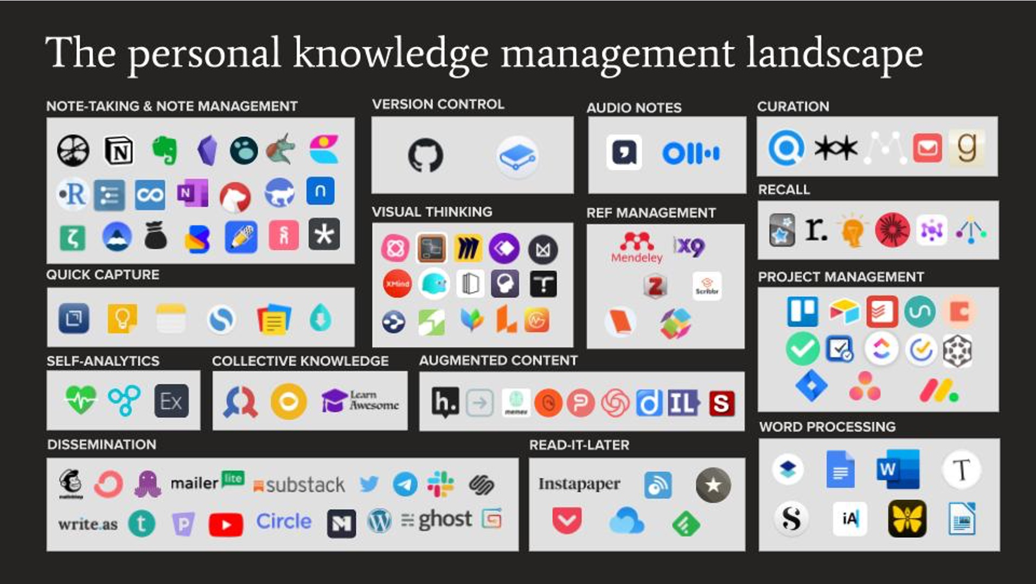

Slide 20
WHAT ARE SOME INDIVIDUAL BARRIERS TO KM INNITIATIVES?

Slide 21
INDIVIDUAL BARRIERS
Lack of time to share knowledge
Age or gender differences
Different level of education or experience
Effective communication, feedback, evaluation
Lack of trust about credibility and accuracy of knowledge
Poor verbal or written communication skills
Lack of coordination or contact time among teams
Fear of job security or recognition in the team be sharing knowledge
Poor social network
Difference in cultural background, values and beliefs
Low awareness about the benefits of sharing knowledge

Slide 22
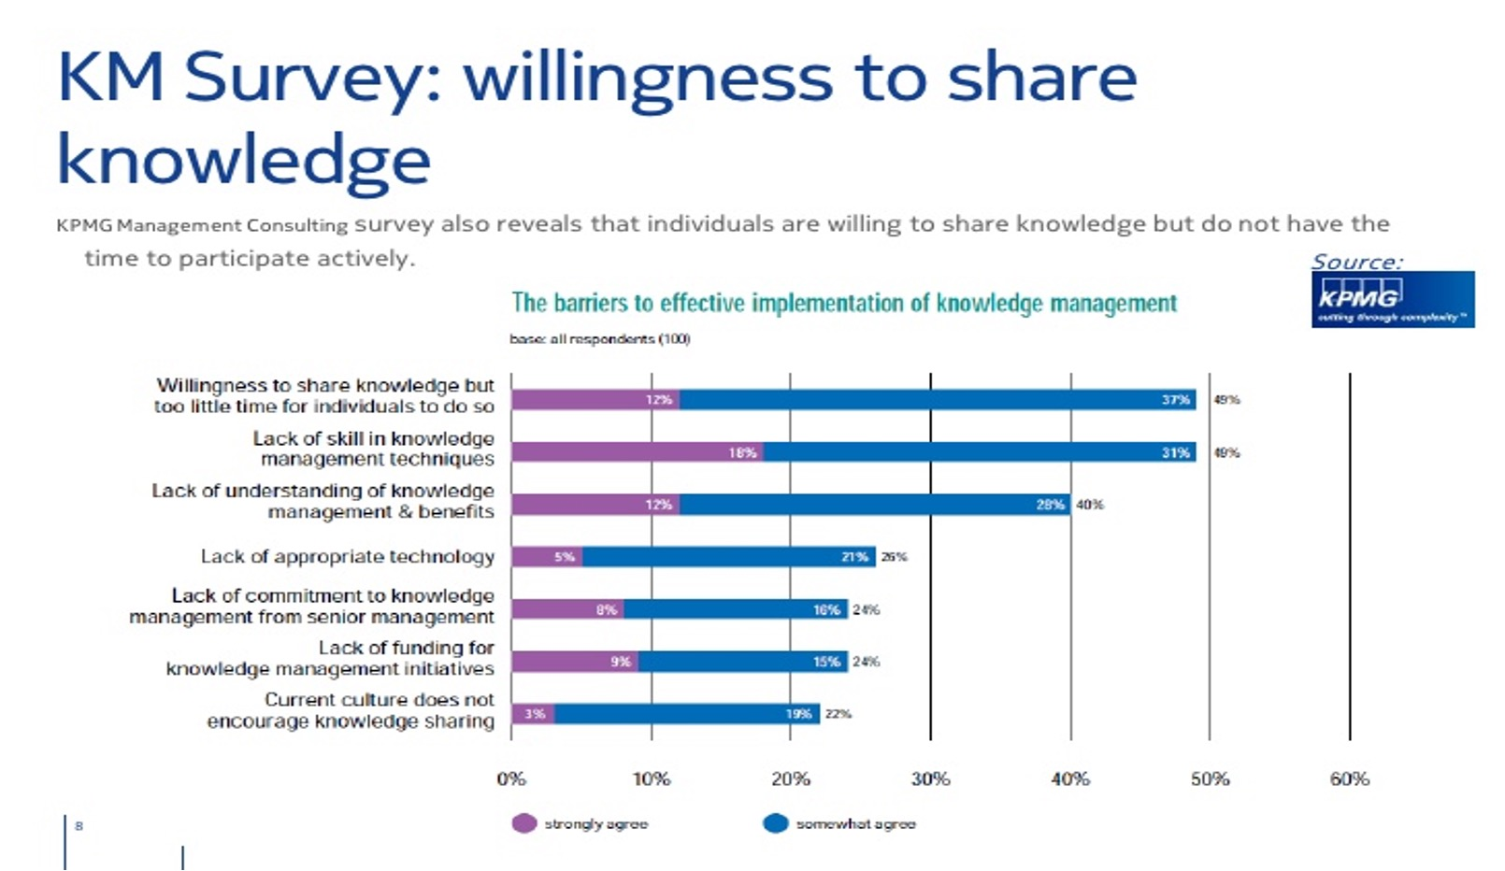

Slide 23
Poll 2: What do you think are the benefits of KM for an organisation?

Slide 24
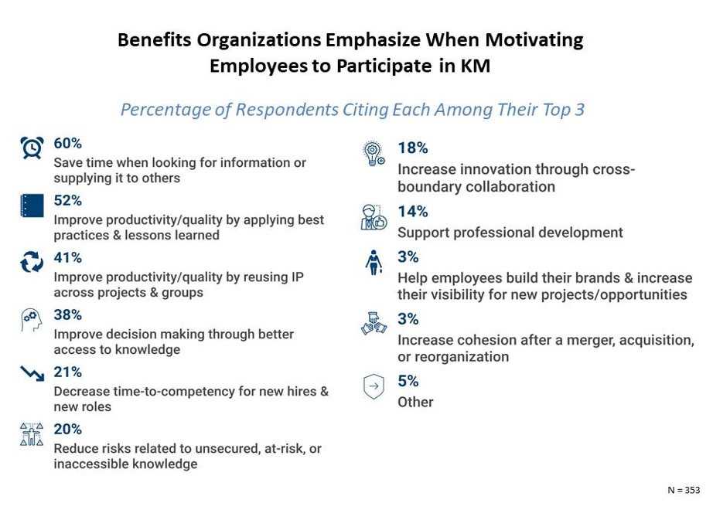

Slide 25


Slide 26
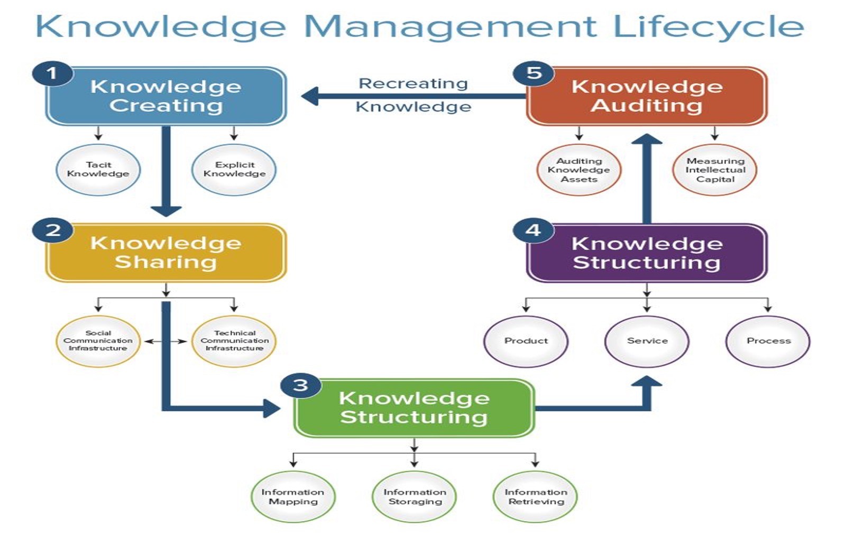

Slide 27
ACTIVITY 4
What are your current EKM practices?
What are your existing EKM Tools?
How do you measure their effectiveness? Is there a policy? Frequency?
How could you improve your EKM practices?
What will be your priorities?

Slide 28
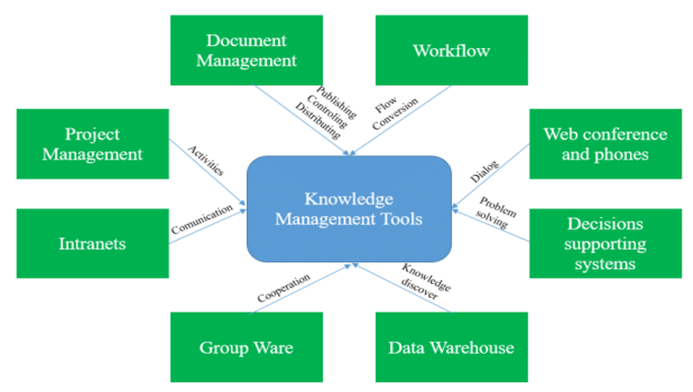

Slide 29
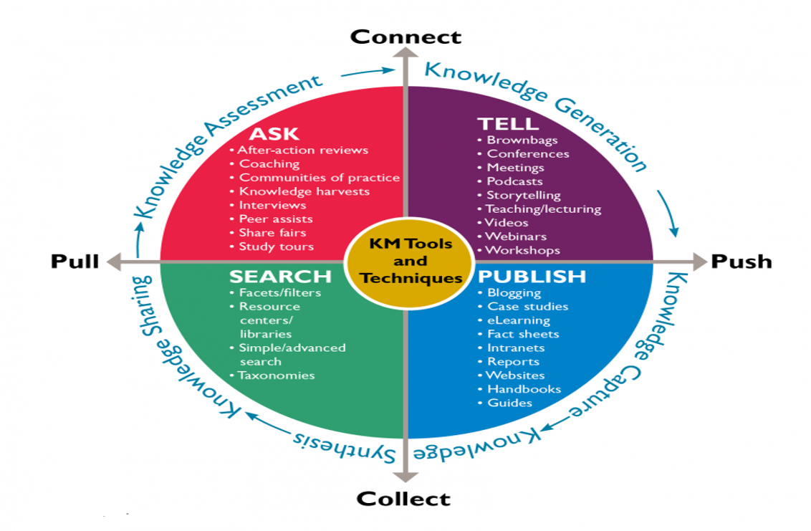

Slide 30
WHAT ARE THE ORGANIZATIONAL BARRIERS OF KM?
Notes:
Now, we should be all conscious and aware of the strategic rôle of KM for our organisational growth. Yet many are still underforming and facing huge challenges to manage their knowledge assets. What do you think could be some of those reasons or barriers to effective EKM practices?

Slide 31
ORGANIZATIONAL BARRIERS
Lack of transparency in recognition and reward system
Lack of formal and informal office space to share knowledge
Unclear integration of knowledge sharing and management strategy
Lack of managerial direction to communicate the benefits of sharing knowledge
Missing corporate culture to encourage sharing practices
External competitiveness among different business functions
Lack of company recourses for knowledge sharing
Hierarchical organizational structure that leads to low sharing practices

Slide 32
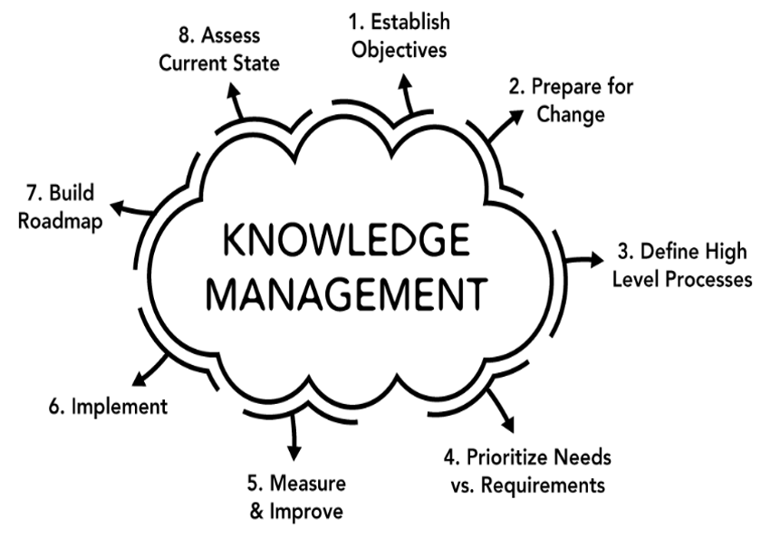
STEPS TO A KM STRATEGY

Slide 33
KM BEST PRACTICES

Slide 34
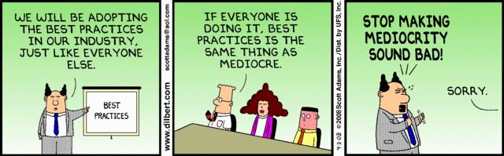
BEST PRACTICES

Slide 35
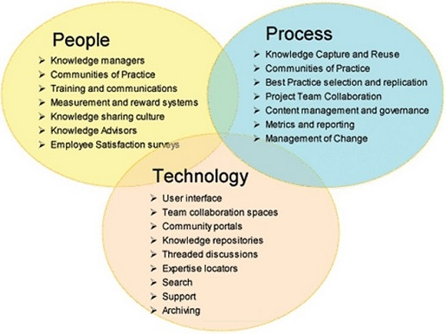
OBSERVING BEST PRACTICES AT 3 LEVELS

Slide 36
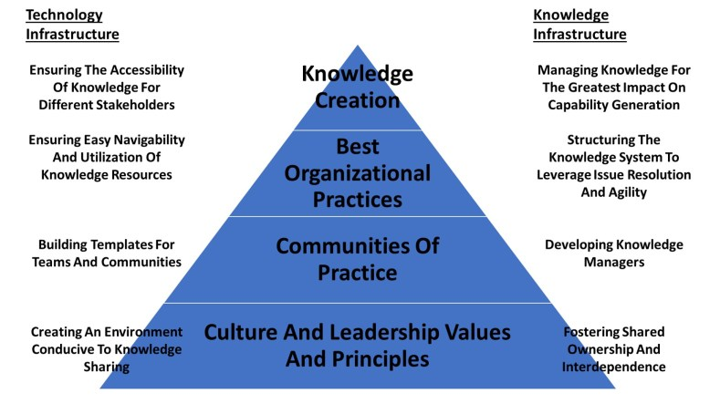
CON’T

Slide 37
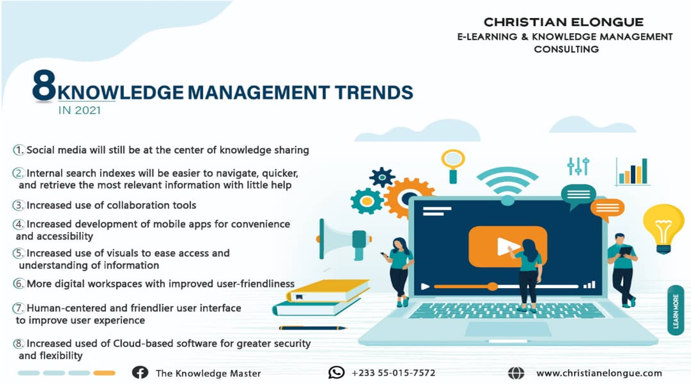

Slide 38
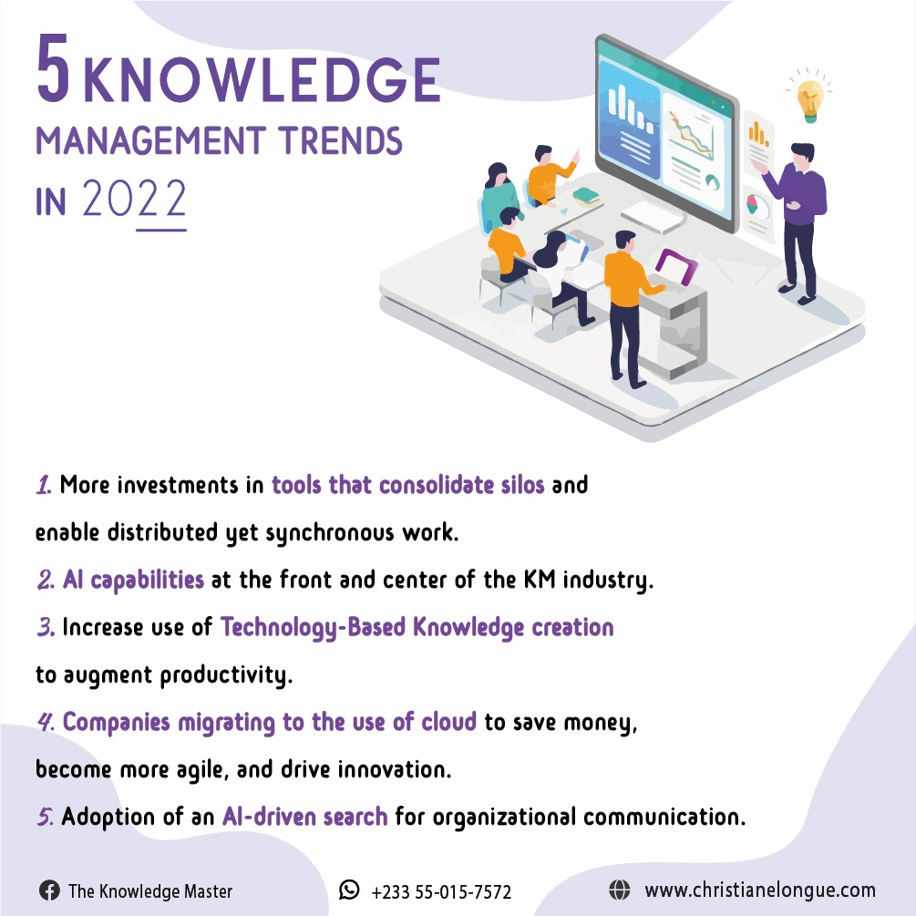

Slide 39
FINAL REMARKS

Slide 40
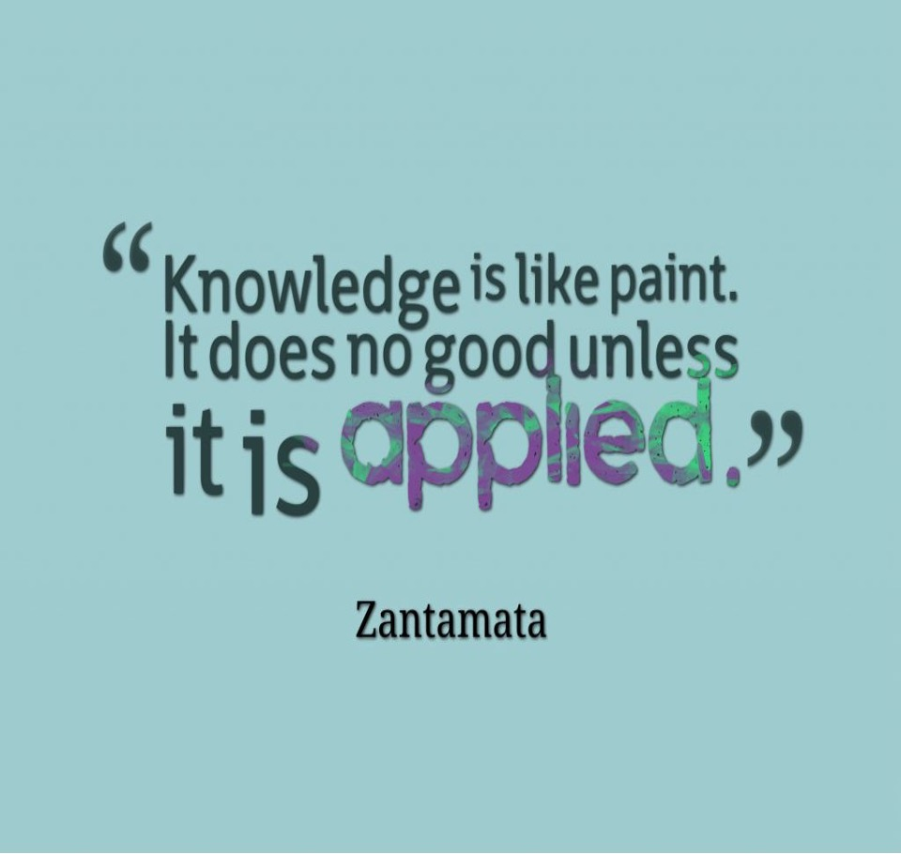

Slide 41


Slide 42
CONTACT INFORMATION
Ngnaoussi Elongue Cedric Christian
LinkedIn Facebook Twitter
hello@christianelongue.com
www.christianelongue.com
Tel: 0550157572 (WA)

