Slide 1
THE POWER OF AI IN TALENT MANAGEMENT & SUCCESSION PLANNING
CHRISTIAN ELONGUE
Knowledge and Talent Management consultant, Kabod Group
elongue@kabodgroup.com

Slide 2
GOALS
Present practical AI Tools that can be used to improve talent management & SP practices within training organisations.
Goal 1
Demonstrate how to leverage these tools to increase effectiveness .
Goal 2

Slide 3
TARGET AUDIENCE
Learning Management System (LMS) Administrator
Training Facilitator
/Trainer
Learning Experience Designer
Training Coordinator
E-learning Developer
Performance Consultant
Chief Learning Officer (CLO)
Instructional Designer
Compensation and Benefits Specialist
Recruiter
Employee Relations Specialist
HR Business Partner
Talent
Acquisition Manager
HR Analytics Specialist
Diversity and Inclusion Manager
HR Director/VP of HR
Organizational Development Specialist
Talent Management Specialist
Workforce Planning Analyst
HR Information Systems (HRIS) Specialist

Slide 4
INTRO
The global AI market is worth $196.63 billion. That's an increase of around $60 billion since 2022.
AI is increasingly being used to increase efficiency in the entire talent management process.

Slide 5
Talent
Management
Process

Slide 6
1. AI-Driven Talent Acquisition
AI is revolutionising recruitment. 43% of learning professionals use AI in hiring processes (Jobylon, 2024)
Ways AI is Used for Talent Acquisition
Automated resume screening
Chatbots forinitial candidate engagement
Predictive analytics forcandidate matching
Statistics from SHRM On Uses of AI in recruiting in 2024
65% for generating job descript
42% for ions customizing job postings
33% forreviewingresumes, communicating with applicants, and automating searches.

Slide 7
AI RECRUITING TOOLS FOR
DIFFERENT PURPOSES
Recruitment
Marketing
Source
Screening
Intrerviewing
Onboarding
Employer branding, social media advertising and CRM
Job boards, social media and career pages
Talent assessment and pre-employment testing
Interview scheduling, automation and video interviews
Organizational resources benefis enrolment, new
hire documentation

Slide 8
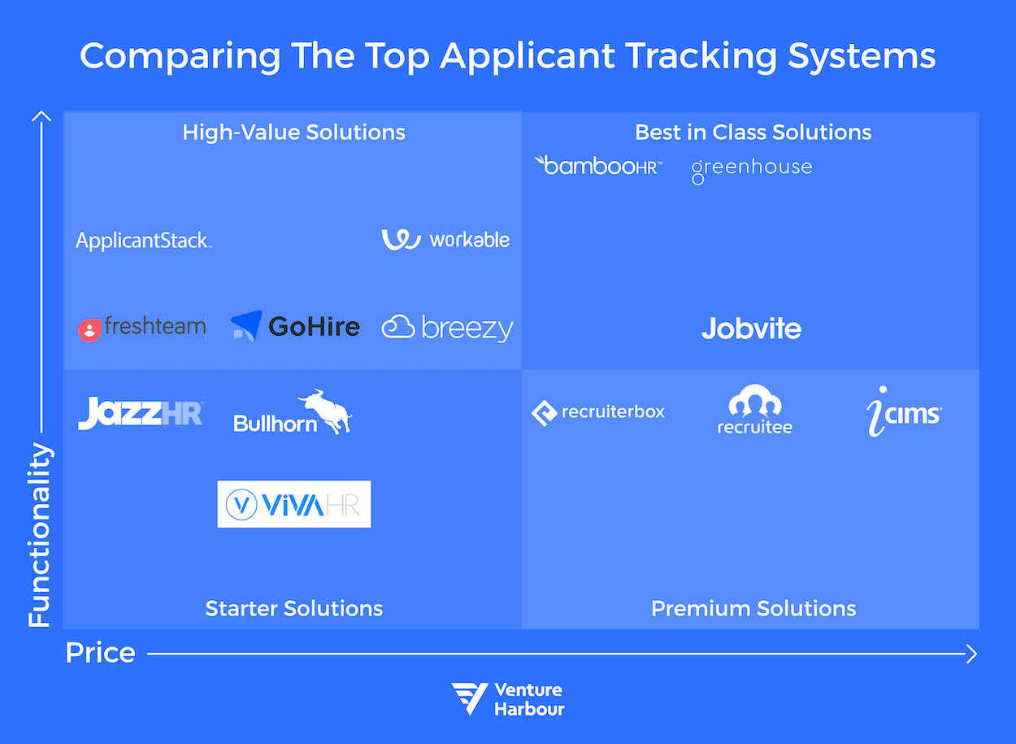
APPLICANT TRACKING TOOLS FOR
DIFFERENT PURPOSES

Slide 9
2. EMPLOYEE DEVELOPMENT
01
AI revolutionizes traditional training methods, catering to evolving needs.
As of 2019, 85% of talent developers use internally created content (LinkedIn, Learning).
02
Today, 49% use AI to recommend or create personalized opportunities, 45% to tracklearning progress, and 19% to upskill/reskill employees.
03

Slide 10
Tools for Employee Development
1.Quizgecko AI : This AI tool is essentially a quiz generator, and makes it easierforyou to create assessments to help boost learners' knowledge and evaluate theirskills.
2. EdApp : It has the functionality forinteractive learning, quizzes, polls, videos, and assessments. But one of the core mechanisms that you may find incredibly useful is its ability to generate an entire course (which of course is customizable).
3. HeyGen : HeyGen is an AI video creatorthat you can use to create training videos without large production budgets. You can select a real-life person as an avatar, input yourcontent, and select the voice you'd like the person to use, orrecord yourown and use the templates library to design the video and graphics.
4. Zavvy AI : Zavvy's AI-powered coach analyzes employee performance and provides recommendations relevant to their needs, creates personalized growth plans, and provides answers and support to learners based on yourcourse content—which saves you the time you'd usually take to provide support and answerquestions.

Slide 11
AI TOOLS FOR EMPLOYEE ENGAGEMENT
Talmundo offers a comprehensive solution foremployee onboarding and engagement.
Rezolve.ai is one of the best Generative
AI-powered employee support and engagement tool that delivers automated and personalized support to youremployees. Works within MS Teams.
01
02
03
Guusto allows HR professionals to create employee reward and recognition programs that elevate
workplace culture.
04
Officevibe is an AI-powered employee engagement tool that helps managers gather and analyze employee feedback,recognize and reward staff, and manage employee performance.
05
Beams.ai is an AI-enabled employee engagement tool that aids in recognizing employees and engagement.

Slide 12
3. AI TOOLS FOR PERFORMANCE
MANAGEMENT
Monday.com is a work management plat form that can help you manage your team's workload. Monday.com is a cloud-based tool that offers a variety of features, such as dashboards, automation, and reporting. Users have the ability to create Kanban boards to visualize work and track its progress.
Leena.ai is revolutionizing the way organizations manage their HR and employee support functions.
This innovative platform leverages artificial intelligence and natural language processing to streamline HR operations, making them more efficient and employee?centric.
Gong stands as a transformative AI-driven revenue intelligence platform tailored for sales teams. By recording and analyzing customer interactions, including calls, emails, and video meetings, it arms sales reps with actionable insights to refine their strategies.
Talla.ai is offering a powerful solution for knowledge management and automation. This AI-driven platform excels in helping organizations streamline their internal processes by providing a centralized hub for information retrieval and task automation.

Slide 13
4. SUCCESSION PLANNING
AI transforms leadership development and succession planning.
Traditional annual succession planning is insufficient; real-time initiatives are necessary.
AI identifies potential leaders through data analysis and predictive modeling.
Uses of AI in succession planning:
Identifying potential leaders
Predictive modeling for
leadership development
AI-driven career
pathing
05

Slide 14
COMPREHENSIVE AI TOOLS
TO TALENT MANAGEMENT
CHALLENGES

Slide 15
TOP CHALLENGES | STATISTICS | AI SOLUTION
1. Talent attraction and retention | 36% of HR leaders reported improving employee experience as top priority (Gartner, 2023) | AI powered recruitment tools (e.g., Pymetrics) for unbiased screening and better candidate matching
2. Skills gap and workforce development | 44% of workers' skills need updating by 2028 (WEF, 2023) | AI-driven personalized learning paths (e.g., Degreed)
3. Employee engagement and satisfaction | Only 23% of employees were engaged at work (Gallup, 2023) | AI-powered sentiment analysis tools (e.g., Glint) for real-time feedback analysis
4. Diversity, equity, and inclusion (DEI) | Companies in top quartile for gender diversity 25% more likely to have above-average profitability (McKinsey, 2023) | AI tools for identifying bias and promoting inclusive language (e.g., Textio)
5. Technology adaptation | 54% of HR leaders planned to increase HR tech investment (PwC, 2023) | AI for task automation and predictive analytics (e.g., Workday)
6. Compliance and regulations | Average cost of non-compliance event: $4 million (Ponemon Institute, 2023) | AI-powered compliance monitoring and reporting (e.g., Securiti.ai)
7. Performance management | 76% of companies rethinking performance management systems (Deloitte, 2023) | AI-driven continuous feedback and insights (e.g., Lattice)
8. Succession planning | Only 35% of organizations had formal succession planning (SHRM, 2023) | AI for identifying potential successors and development paths (e.g., SAP SuccessFactors)
9. Employee wellness and mental health | 76% of employees reported work-related stress (APA, 2023) | AI-powered wellness recommendations and mental health support (e.g., Ginger)
10. Change management | 75% of organizations expected to multiply major change initiatives (Gartner, 2023) | AI for predicting change resistance and personalizing communication (e.g., Qualtrics)

Slide 16
CASE STUDIES
TECHBULLISH | Uses AI-powered recruitment tools for precise and efficient candidate screening.
ROADSURFER | Uses AI in onboarding, using interactive quizzes, personal scorecards, and auto-triggered reminders.
PANASONIC NORTH AMERICA | Uses the AI (Visier) for data, analytics, and real-time insights, improving employee experience and productivity
HYPERCONTEXT | Uses Donut's AI-backed chatbot forfostering a remote culture and connecting team members.
GOOGLE | Uses Custom-built equation for intelligent promotion decisions
PITCHGRADE | Uses AI forscanningresumes and identifying suitable candidates, resulting in fasterhiring and improved candidate experience.

Slide 18
LIVE DEMO

Slide 19
CONCLUSION
AI is transforming talent management and succession planning, addressing modern challenges and optimizing HR processes.
Embracing AI can enhance recruitment, employee development, performance management, engagement, and succession planning.
Organizations must adapt to leverage AI's potential fully, ensuring competitiveness and success.

Slide 20
THANK YOU
FOR YOUR ATTENTION
Calle Cualquiera 123, Cualquier Lugar
CHRISTIAN ELONGUE
Knowledge and Talent Management consultant, Kabod Group
elongue@kabodgroup.com
+233 055 015 7572

