Slide 1
Taking Grow Learn Connect Courses
on the Open Learning Campus (OLC) Platform
Registration and Login Instructions
New User
Sign-up & login
Existing user
Login

Slide 2
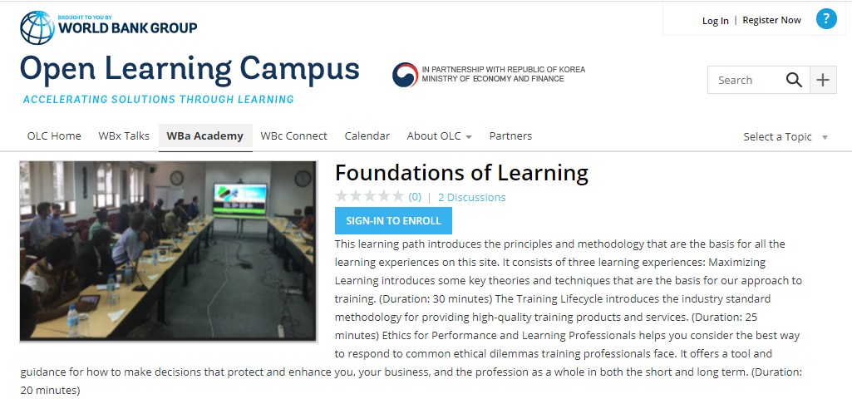
Once you click on the course link on the GLC website, you will be taken to the hosting platform – WBG Open Learning Campus

Slide 3
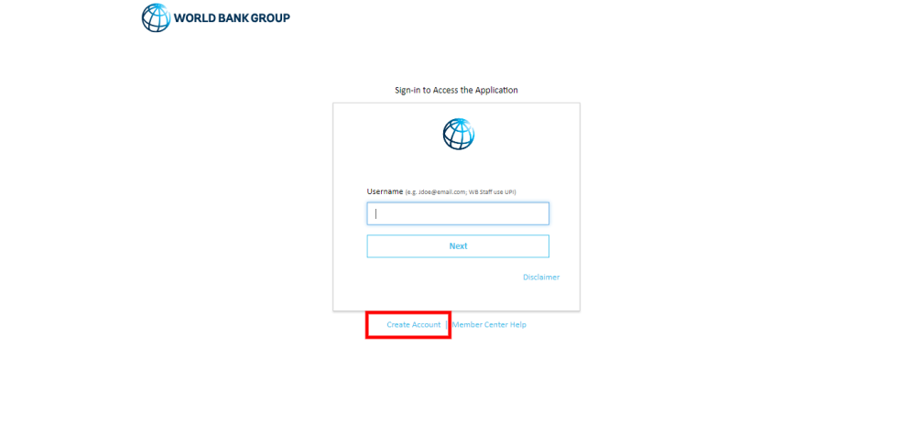
2. You will be redirected to the screen below with the option to log in and also to Create Account. If you already have a OLC account, you can directly sign in. To create an account click on “Create Account”.

Slide 4
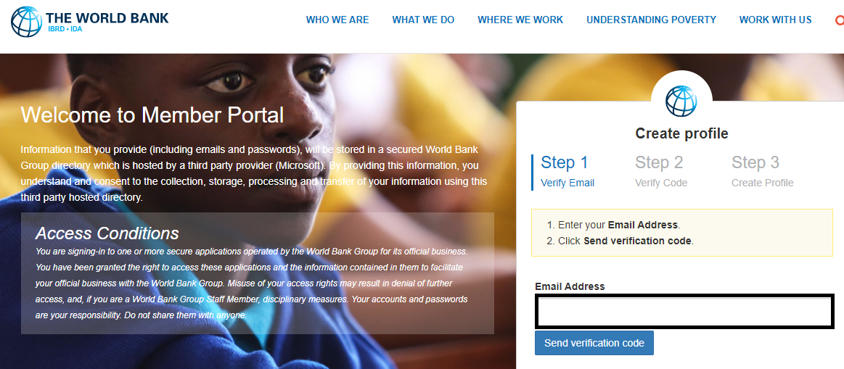
3. In the sign-in form, provide an email and click on the button “Send Verification Code”. Then access your personal email account, where you should have received an email with a code. The email would be from Microsoft on behalf of The World Bank Group.

Slide 5
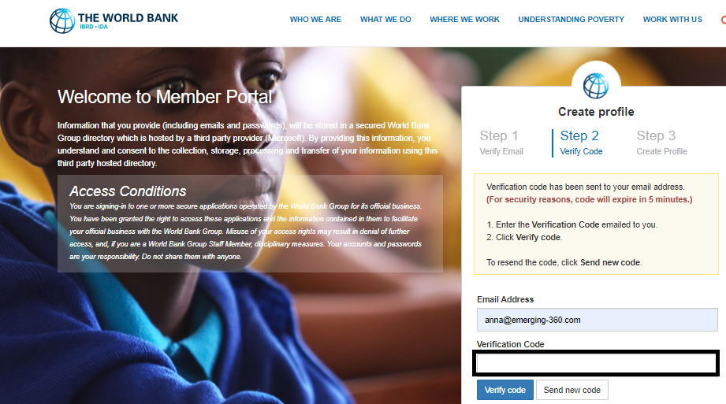
4. Enter the verification code and click on “Verify Code”.

Slide 6
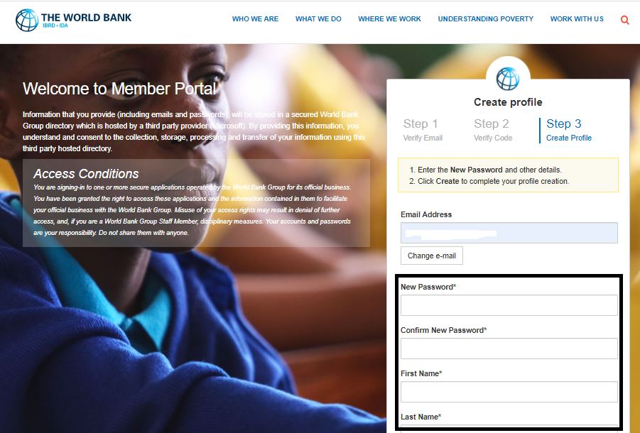
5. Once the code is validated, fill in the remaining fields, such as password, first name, last name, etc., and click on the Create button. Your password must have at least 3 of the following: a lowercase letter, an uppercase letter, a number, and a symbol.

Slide 7
6. If you’re not immediately taken back to the GLC courses on OLC, you can search for them by course names or you can enter the following urls into the address line:
Foundations of Learning (English): https://olc.worldbank.org/content/foundations-learning
Foundations of Learning (French): https://olc.worldbank.org/content/les-fondements-de-lapprentissage
Finding your Path for Facilitation (English): https://olc.worldbank.org/content/finding-your-path-facilitation-self-paced
Finding your Path for Facilitation (French): https://olc.worldbank.org/content/trouver-votre-mode-d’animation
More courses will be added soon. Stay tuned.
HAPPY LEARNING WITH GROW LEARN CONNECT

